Slide 1

HANDWRITTEN DIGIT RECOGNITION USING ANN
Presented by-pritiranjan biswal
Intern id-stb03005
Guided by-urooj khan

Slide 2
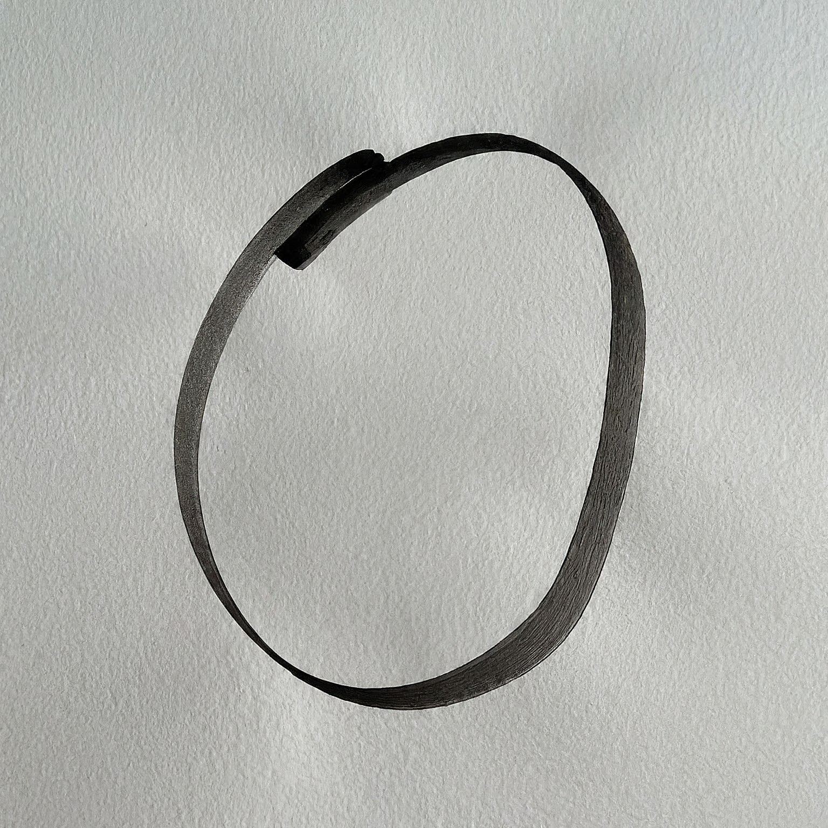
WHAT IS HANDWRITTEN DIGIT RECOGNITION:
The ability of a computer system to identify and classify handwritten digits
Used in various applications like postal automation, check processing, and educational technology
Challenging task due to variations in writing styles, sizes, and orientations

Slide 3
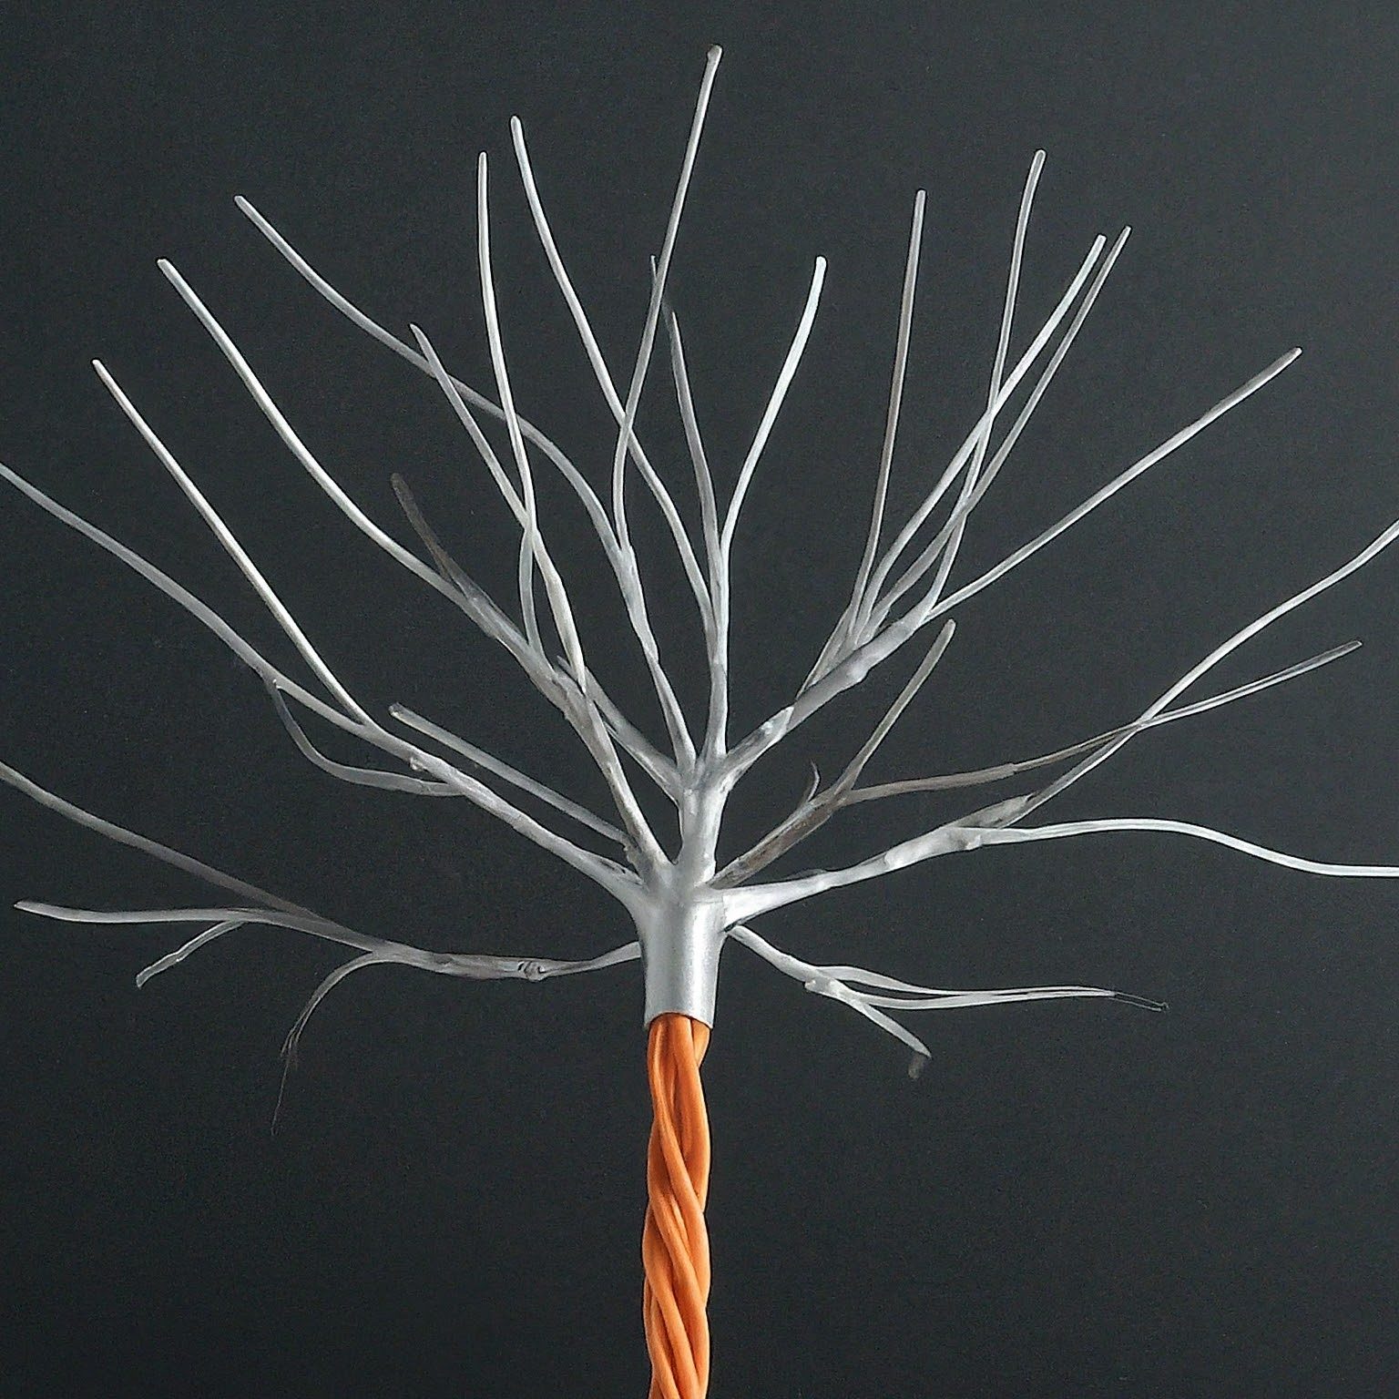
WHAT ARE ARTIFICIAL NEURAL NETWORK?
Inspired by the human brain
Made up of interconnected nodes (neurons)
Learn patterns from data
Can solve complex problems

Slide 4
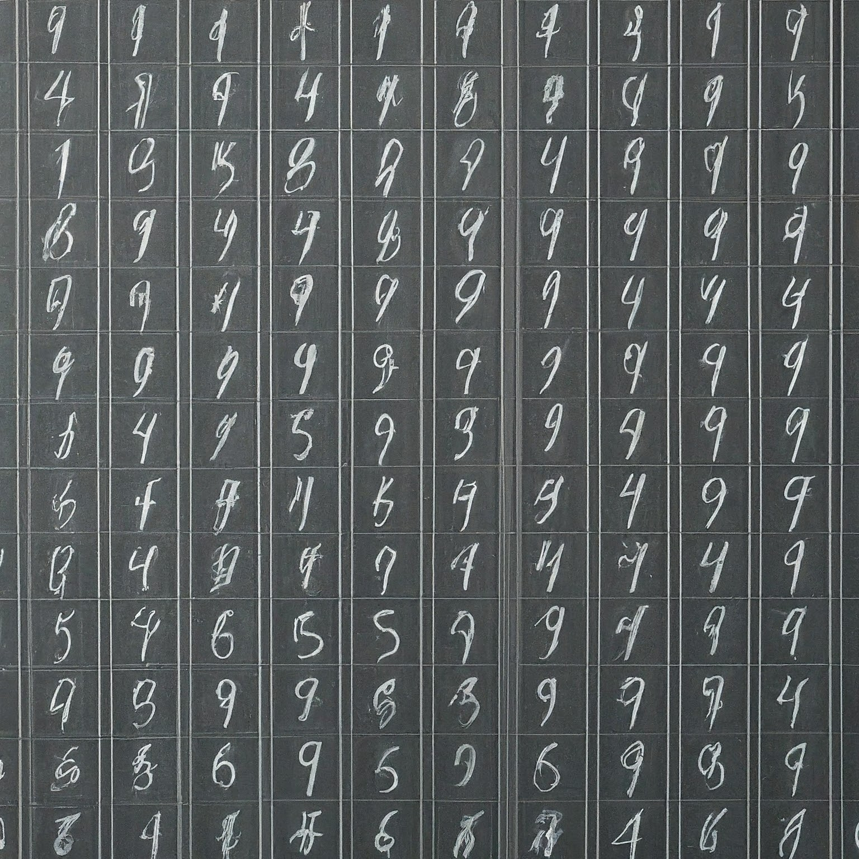
WHAT IS MNIST DATASET?
A popular benchmark dataset for handwritten digit recognition
Contains 70,000 images of handwritten digits (28x28 pixels)
60,000 images for training and 10,000 images for testing
Each image is labelled with the corresponding digit (0-9)

Slide 5
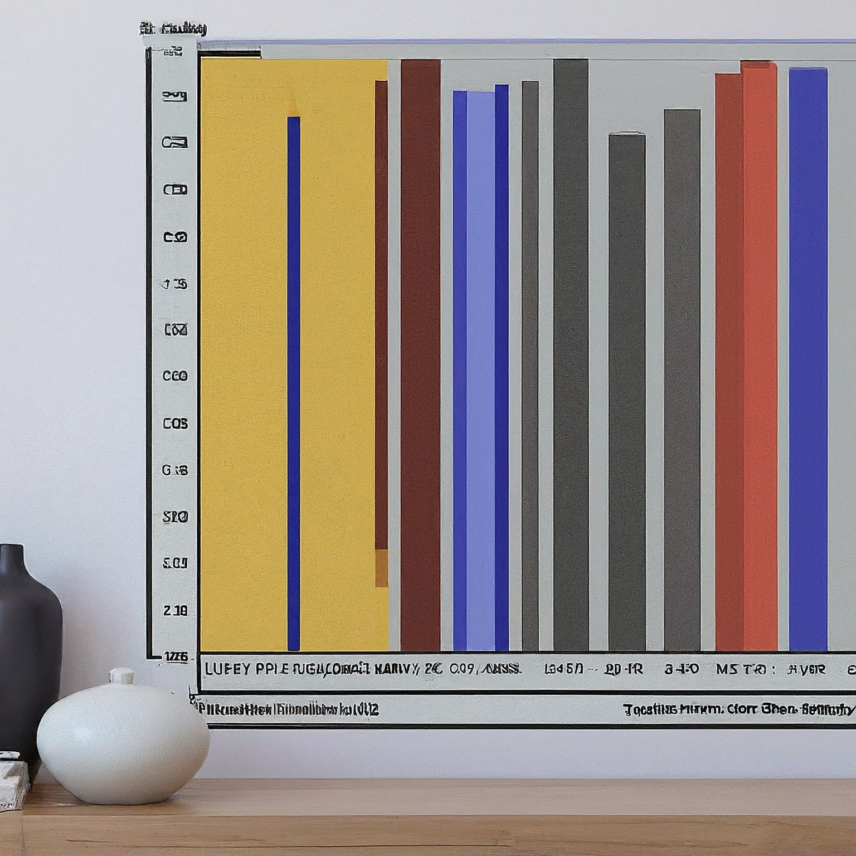
PREPARATION OF DATA-NORMALIZATION MAGIC :
Transforming pixel values from their original range of 0-255 to a normalized range of 0-1.
This ensures all values fall within a similar range, enhancing the training process for our neural network.

Slide 6
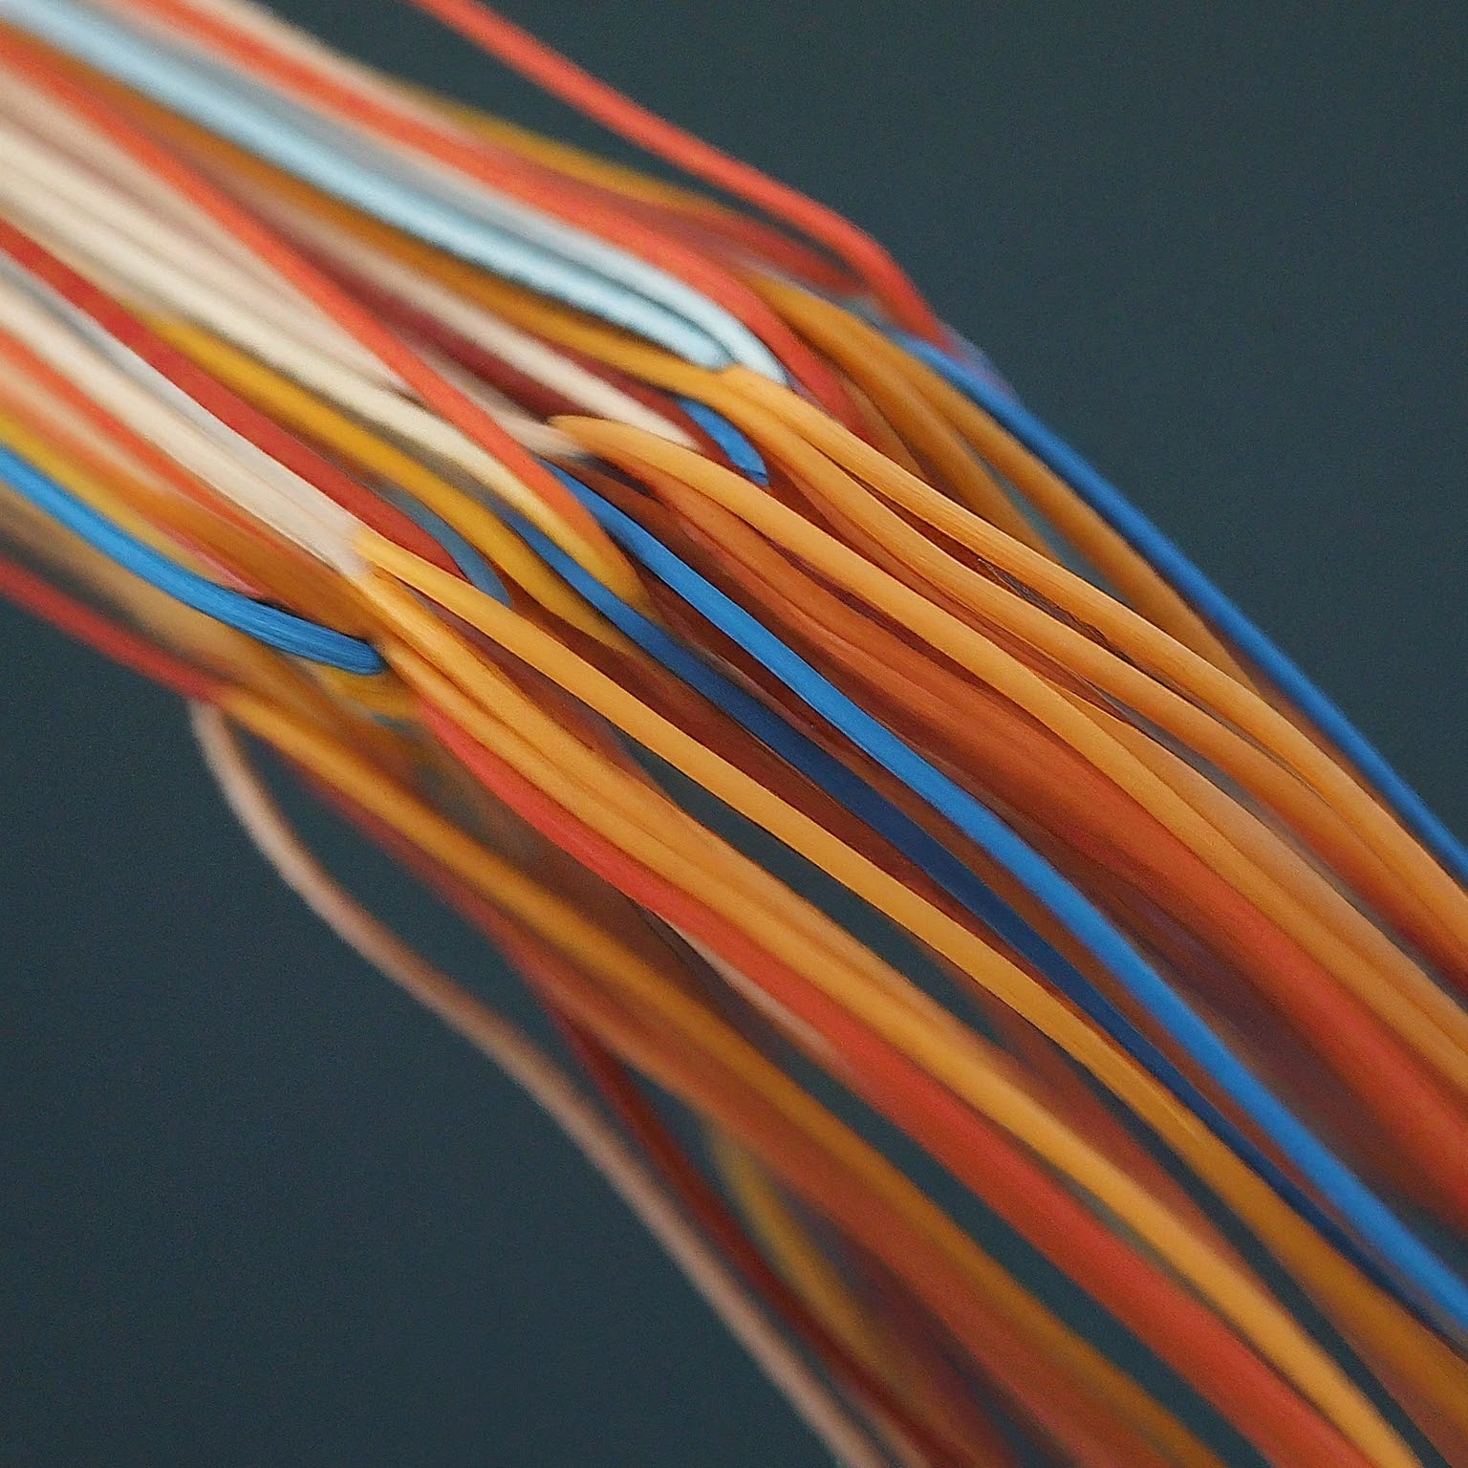
BUILD THE ANN:
Preprocess the MNIST dataset (normalize, flatten)
Define the ANN architecture (input, hidden, output layers)
Choose an activation function (e.g., ReLU)
Define a loss function (e.g., categorical cross-entropy)
Train the ANN using an optimizer (e.g., Adam)
Evaluate the model's performance on the test set

Slide 7
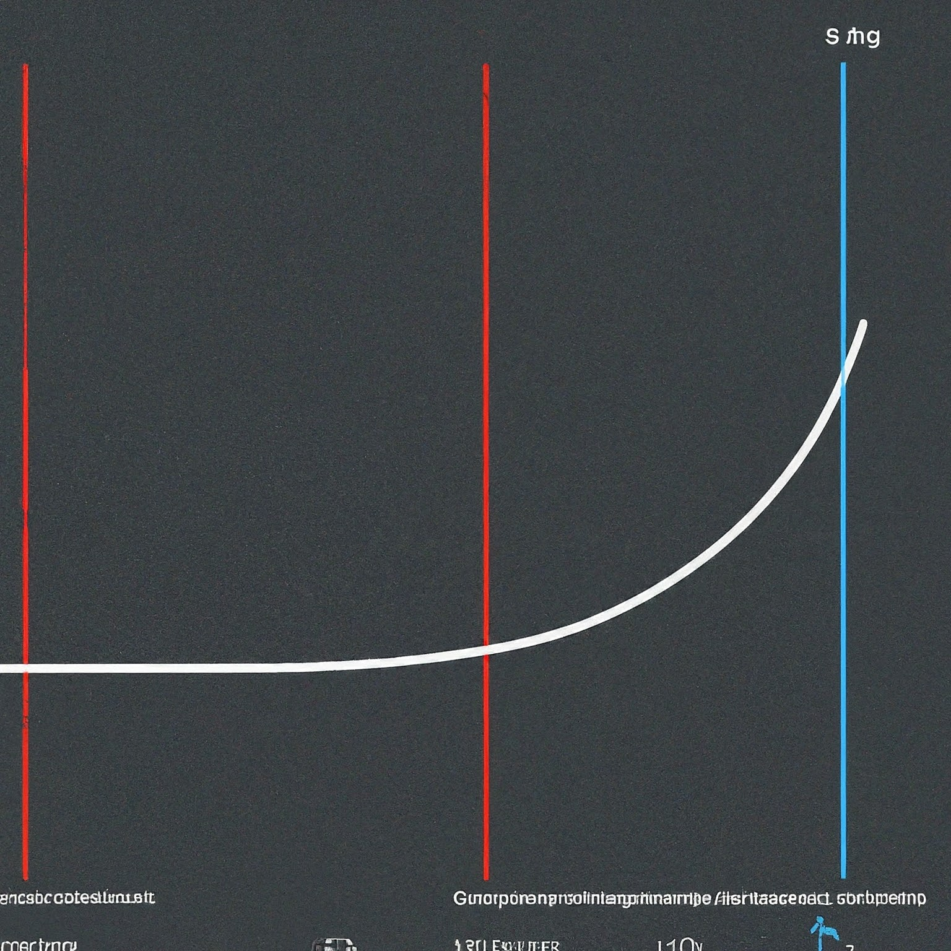
TRANING THE MODEL :
Data Split: To prevent overfitting (memorizing training data without generalizing well), we split the training data into two parts:
Epochs: Each epoch represents one complete pass through the entire training set. We train the model for multiple epochs (25 in this case) to allow it to learn effectively.
Loss Function: We use "sparse_categorical_crossentropy" as the loss function, measuring the difference between the model's predictions and the true labels.
Optimizer: The "Adam" optimizer helps adjust the model's parameters based on the calculated loss, guiding it towards better performance.

Slide 8

REFINING THE MODEL-MONITORING PROGRESS AND EVALUATION :
Training and Validation Curves: We plot the training and validation loss/accuracy curves to track the model's progress.
Training Curves: Ideally, they should decrease steadily, indicating the model is learning the patterns in the data.
Validation Curves: They should also decrease, but may fluctuate slightly, as they represent performance on unseen data.
Accuracy: We calculate the accuracy on the test set after training to assess the model's generalization ability on completely new data.

Slide 9
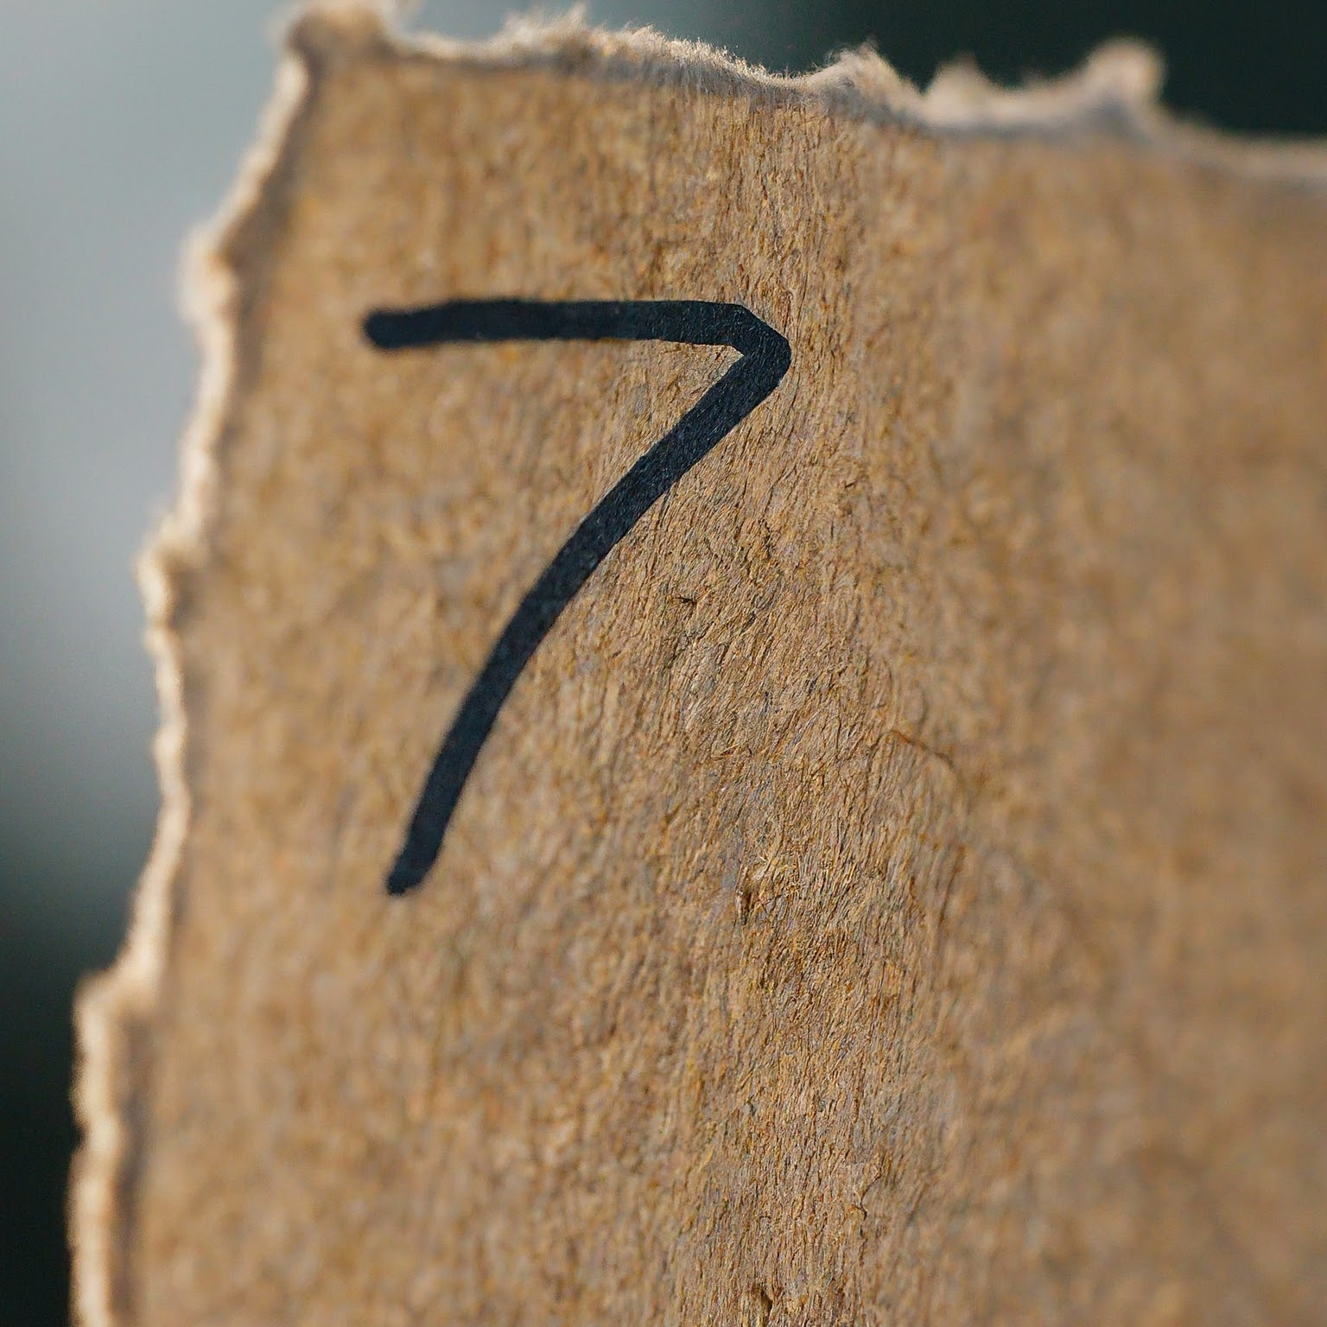
UNVEILING THE RESULT-PREDICTION AND CONFIDENCE :
Making Predictions: We use the trained model to predict the digits in the test set images.
We feed each image into the model, and it outputs a vector of probabilities for each digit class (0-9).
The digit with the highest probability is considered the model's prediction.
Measuring Confidence: We also obtain confidence scores for each prediction. These scores represent how certain the model is about its predictions. Higher confidence scores indicate greater certainty.

Slide 10
CONCLUSION :
ANNs have achieved high accuracy in handwritten digit recognition, exceeding human performance.
Continuous research explores deeper and more complex architectures, like Convolutional Neural Networks (CNNs), for even better results.
Applications extend beyond digit recognition, including object recognition, speech recognition, and medical image analysis.

Slide 11
THANK YOU

